Slide 1
Hangman Parallelization

Slide 2
Serial without parameter change
Total wins: 9879
Total games played: 10000
Win rate: 98.79%
Total time for 10000 games: 2.165 seconds
Simulates a hangman game strategy where the computer guesses letters either randomly or strategically based on letter frequencies in the English language.
The code's goal is to simulate multiple games of hangman with a predefined word list (word_list) using a specific guessing strategy, measure the outcomes, and report statistics such as total wins, win rate, and execution time.
The hangman game strategy combines randomness (std::rand()) with strategic letter guessing based on English letter frequencies.
The use of std::random_device, std::mt19937, and std::uniform_real_distribution ensures random selection of letters

Slide 3
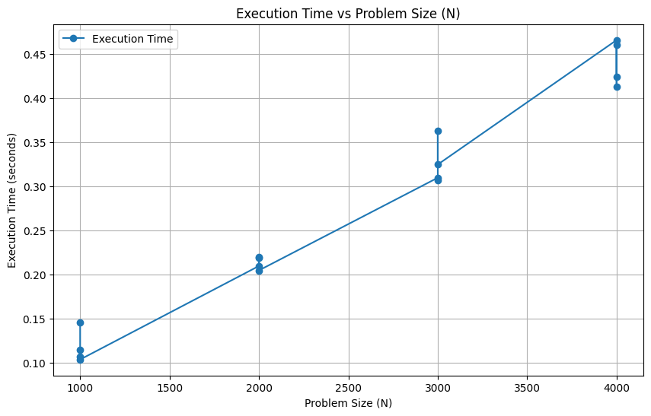
Serial without parameter change

Slide 4
Parallel without parameter change
Total wins: 6872Total games played: 10000
Win rate: 68.72%
Total time for 10000 games: 0.584 seconds
Speedup: 17123.3
Efficiency: 342466%
Purpose is to simulate multiple games of hangman concurrently using OpenMP to distribute the workload across multiple threads.
This allows for efficient processing of a large number of games and enables performance analysis in terms of speedup and efficiency.
The code utilizes OpenMP (#pragma omp parallel for) to parallelize the simulation of hangman games across multiple threads (num_chunks threads).
Each thread executes simulate_hangman_games for its assigned chunk of words (word_list_chunks), improving performance by distributing the workload.

Slide 5
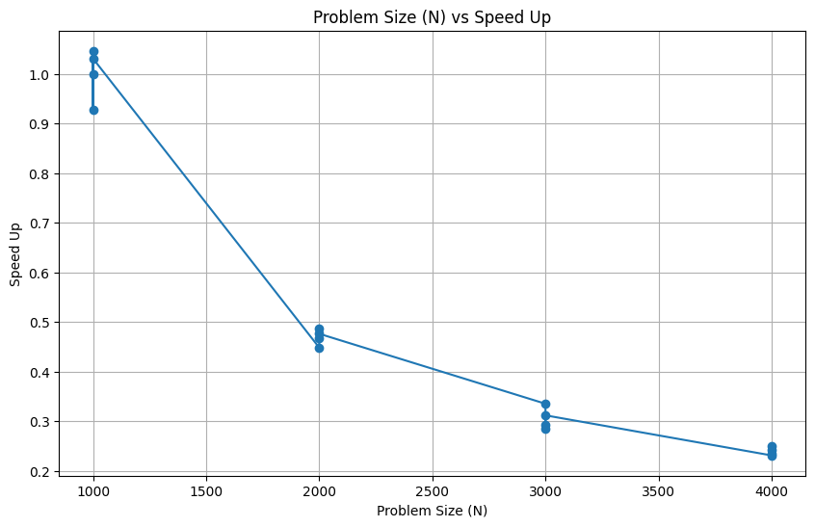
Parallel without parameter change

Slide 6
Serial with parameter change
Serial execution of the game happens using parameters.
In the main function, each iteration of the outer loop handles a specific combination of problem size (N) and number of processing elements (P).
After setting these parameters, the function calls measureExecutionTime to measure how long it takes to run simulations of hangman games.
The measureExecutionTime function works by splitting the word list (wordList) into segments (or chunks) based on the specified number of processing elements (numChunks).
It then uses OpenMP (a method for parallel processing) to distribute the task of simulating hangman games across these chunks. This means that multiple parts of the word list can be processed simultaneously by different computing elements.

Slide 7
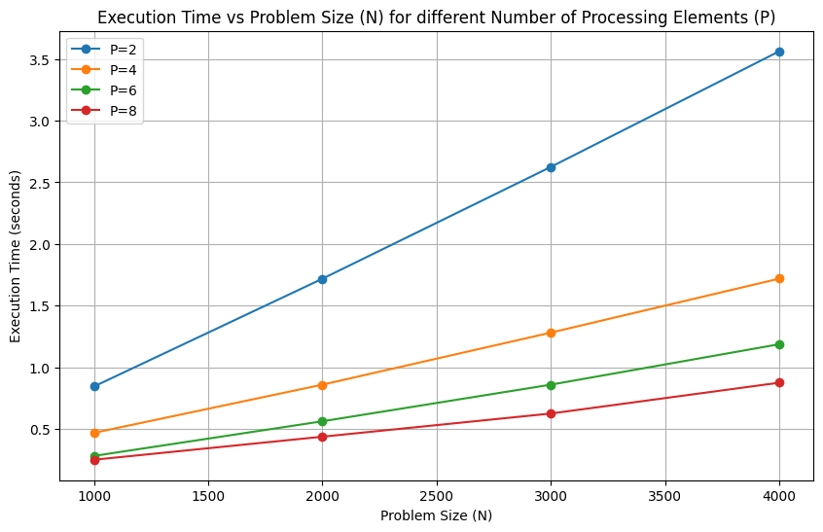
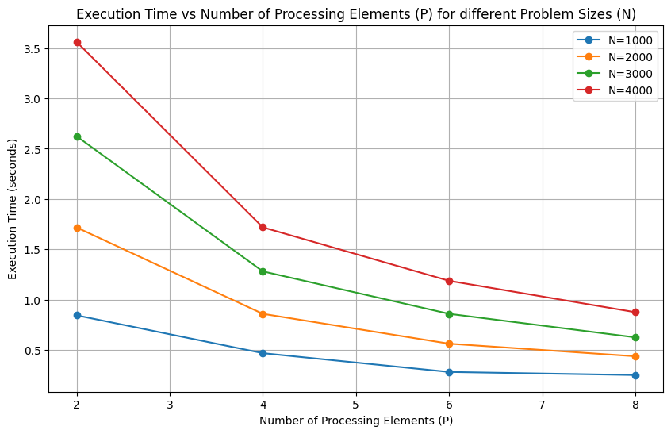
Serial with parameter change
Problem Size (N), Number of Processing Elements (P), Execution Time (seconds)1000, 2, 0.8751000, 4, 0.4061000, 6, 0.2961000, 8, 0.2032000, 2, 1.7352000, 4, 0.9212000, 6, 0.5782000, 8, 0.4533000, 2, 2.6093000, 4, 1.3593000, 6, 0.893000, 8, 0.644000, 2, 3.5784000, 4, 1.7814000, 6, 1.1794000, 8, 0.914--------------------------------Process exited after 18.55 seconds with return value 0Press any key to continue

Slide 8
Parallel with parameter change
The code aims to simulate a parallelized hangman game solver and measure its performance under different problem sizes (number of words to guess, N) and levels of parallelism (number of processing elements, P).
The simulation involves guessing words through randomized letter selections, and the performance metrics are captured using timing measurements.
The code utilizes OpenMP (#pragma omp) to parallelize the hangman game simulations across multiple threads (numChunks threads). Each thread handles a chunk of the wordList.

Slide 9
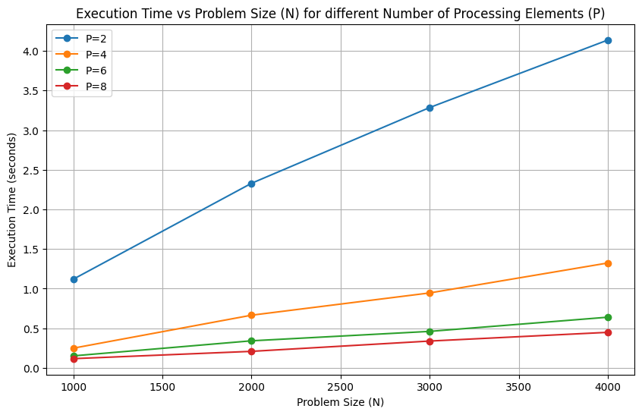
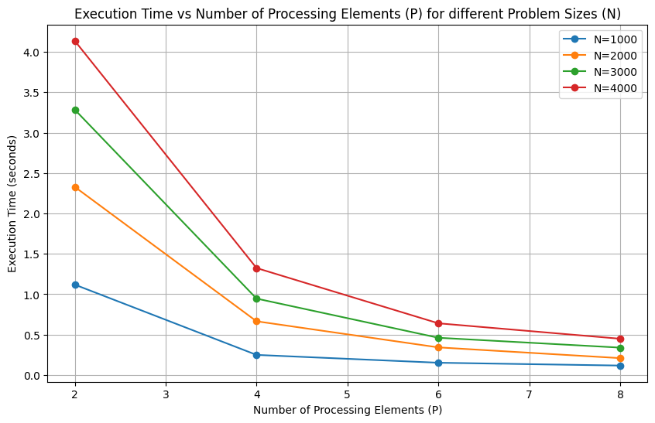
Parallel with parameter change
Problem Size (N), Number of Processing Elements (P), Execution Time (seconds)1000, 2, 1.1191000, 4, 0.2491000, 6, 0.1521000, 8, 0.1172000, 2, 2.3292000, 4, 0.6652000, 6, 0.3422000, 8, 0.2093000, 2, 3.2853000, 4, 0.9463000, 6, 0.4613000, 8, 0.3394000, 2, 4.1374000, 4, 1.3244000, 6, 0.644000, 8, 0.449--------------------------------Process exited after 17.06 seconds with return value 0

Slide 10
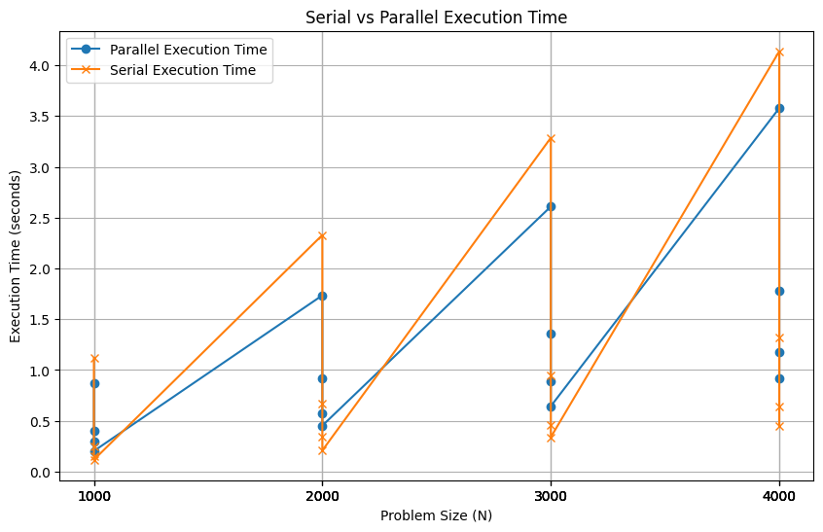
Serial vs Parallel Execution time

Slide 11
Letter based parallelization
Total wins: 962
Total games played: 100000
Win rate: 0.962%
Total time for 100000 games : 0.36 seconds
This code simulates a parallelized Hangman game with multiple word chunks.
It divides a list of words into segments, then uses OpenMP to parallelize game simulations across these segments.
Each game instance attempts to guess letters in a word within a limited number of turns.
The outcome (win or lose) of each game is recorded and summed up. Finally, the total wins, games played, win rate, and total simulation time are displayed.

Slide 12
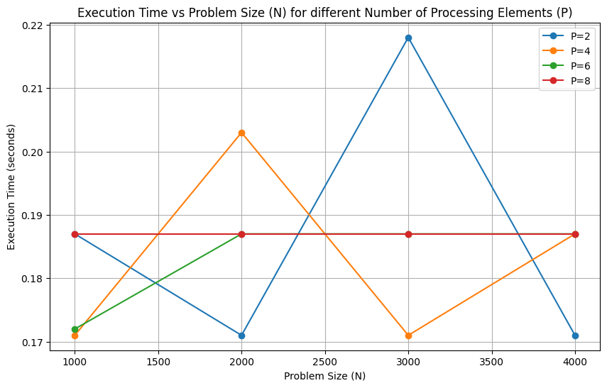
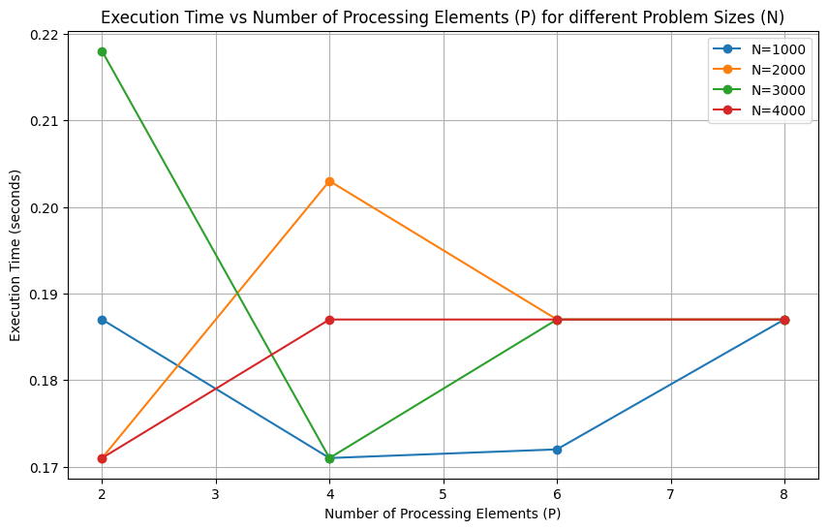
Letter based parallelism

